Slide 1
ROBOT KINEMATICS
Dr. R. SIVARAMAKRISHNAN
ASSOCIATE PROFESSOR
DEPARTMENT OF PRODUCTION TECHNOLOGY
MIT CAMPUS
ANNA UNIVERSITY CHENNAI

Slide 2
Outline
Design Parameters of Robot Manipulators
Kinematics
Degrees of Freedom
Types of Kinematics
Homogeneous Transformations
Geometric Approach
  Forward and Inverse Kinematics of Planar and Spatial Robots
Algebraic Approach (D-H Representation)
  Forward and Inverse Kinematics of Planar and Spatial Robots
Case Studies
26.09.2014

Slide 3
Design of Robot manipulators
Depends upon
Application
Configuration
Work Volume
Payload
Inertia Force
Centre of Gravity
Speed
Kinematics
26.09.2014

Slide 4
WORK VOLUME or WORK ENVELOPE:
The space within which the robot can manipulate its wrist end is known as work volume.This avoids the complication of different sizes of end effectors that might be attached to robots wrist.This is determined by the following physical characteristics of the robot.
Robot’s Physical configuration, Size of the body,arm and wrist components,The limits of robots joint movement
According to physical configuration ,a robot is classified as
CONFIGURATION WORK VOLUME
Jointed arm Spherical
Cylindrical Cylindrical
Cartesian Cartesian or Rectangular
Polar Partial sphere
SCARA Cylinder
26.09.2014

Slide 5
Payload
Plays a vital role in the design of manipulators
It is the load carried by the robot at the wrist end of the robot when its arm is fully stretched or fully extended
It includes the end effector weight also
The Payload to Weight ratio should be in the ratio of 1:200
26.09.2014

Slide 6
Inertia force
Another important parameter influencing the design & performance of robot
Depends upon the payload,speed and acceleration of the robot while in motion
It always acts in the direction opposite to that of the motion of the manipulator
26.09.2014

Slide 7
Centre of Gravity
It is the point where the entire weight of the robot is said to be concentrated
Plays a important role in the design of manipulators especially in Bipedal robots, humanoid robots and articulated robots
Depends upon the weight of the links, actuators, joints, transmission elements and payload
26.09.2014

Slide 8
Speed
It is defined as how quickly the robot will move from one position to the next
Higher speed affects the stability of the robot
Pneumatic actuators give maximum speed compared to hydraulic and electrical actuators
26.09.2014

Slide 9
Dynamics
It is the branch of physical science which deals with bodies which are in motion
Divided into
  Kinetics
  Kinematics
Kinetics deals with the inertia force of the body
Both play vital role in the area of robotics
26.09.2014

Slide 10
Kinematics
It is the branch of dynamics which deals with the relative motion existing between members
Motion of one body with respect to another body
  Relative Position
  Relative Motion
  Relative Velocity
  Relative Acceleration
26.09.2014

Slide 11
Planar and Spatial Robots
Planar
  The robots configured in such a way that the workspace of the robot is limited to a plane are called as planar robots
Spatial Robots
  The robots whose end effector has access to any point in space (of course limited to the work volume)
26.09.2014

Slide 12
Degrees of freedom
Degree of Freedom is the number of independent relative motion in the form of translation and rotation
The body in space has got the maximum of 6 degrees of motion(3 translatory & 3 rotary motions)
Each Translatory has 1 DOF and each Rotary has 1 DOF
26.09.2014

Slide 13
Degrees of freedom
Positioning
  Positioning the end effector in the 3D space, requires three DoF, either obtained from rotations or translations
P
Reference frame origin
z
x
y
26.09.2014

Slide 14
Degrees of freedom
Orientation
  Orienting the end effector in the 3D space, requires three additional DoF to produce the three rotations.
roll
P
tilt
pan
Reference frame origin
z
x
y
26.09.2014

Slide 15
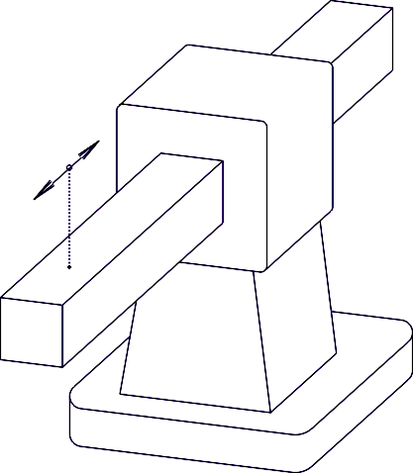
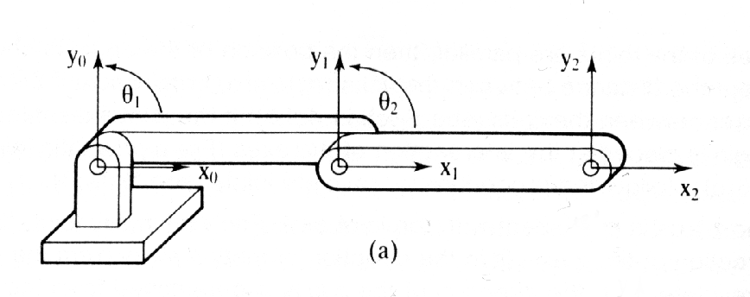
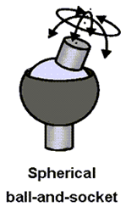


Basic Joints
Rotational Joint(R)
1 DOF
Prismatic Joint(L)
1 DOF (linear)
Twist Joint(T)
1 DOF
3 DOF
Revolving Joint( V)
1 DOF
26.09.2014

Slide 16
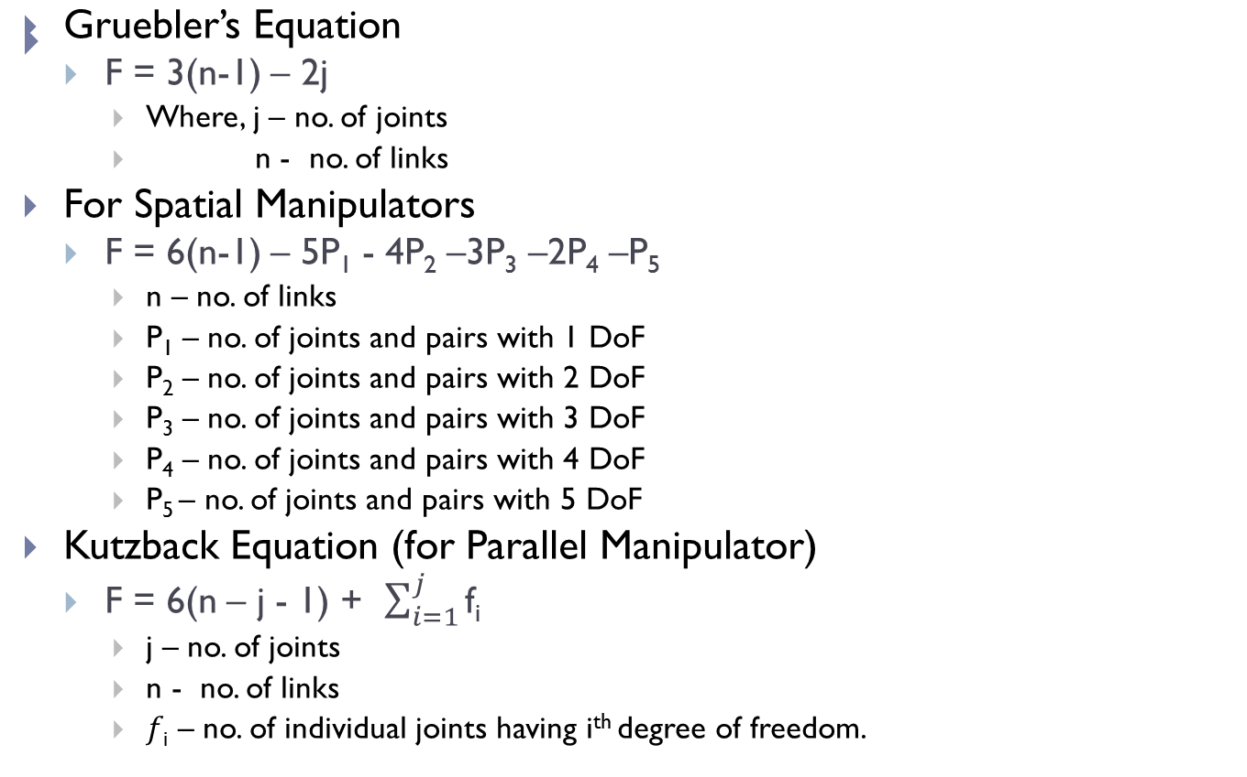
Degrees of Freedom of Robots
I
26.09.2014

Slide 17
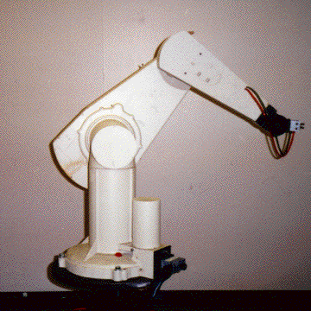
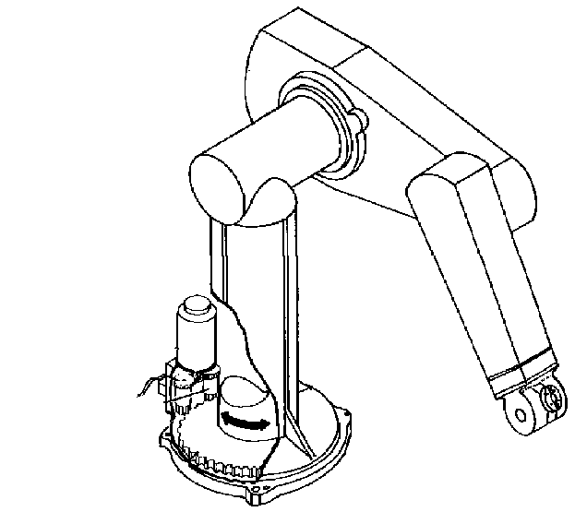
An Example - The PUMA 560
There are two more joints on the end effector (the gripper)
The PUMA 560 has SIX revolute joints
A revolute joint has ONE degree of freedom ( 1 DOF) that is defined by its angle
INDUS
26.09.2014

Slide 18
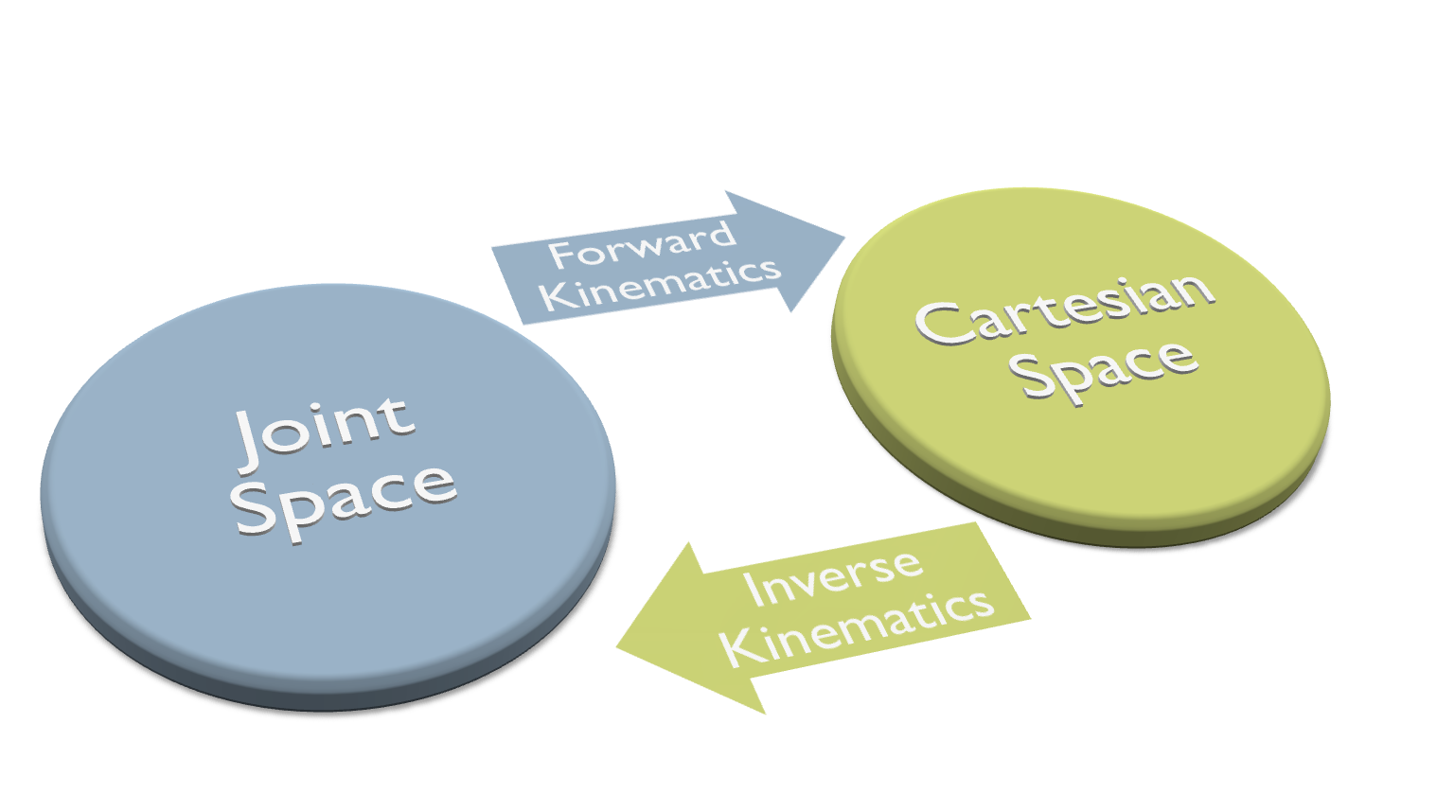
Types of Kinematics
INDUSTRIAL ROBOTICS - TECHNOLOGY, PROGRAMMING AND APPLICATIONS
20-12-2010

Slide 19

26.09.2014

Slide 20
Homogenous Transformation
A matrix H will be considered such that an operator which transforms a point (attached with a frame) or a vector X, into another point or vector then
Y = H X
If Y is a 4x1 column matrix and H, a 4x4 column matrix and X, a 4x1 column matrix then y is obtained by pre-multiplying the ‘X’ column matrix by a 4x4 transformation matrix ‘H’.
26.09.2014

Slide 21
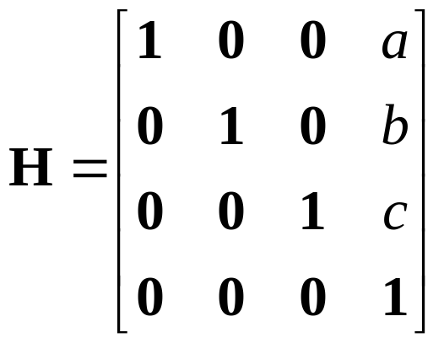
Translation
We define the translation transformation as Trans (a, b, c) as the operator that moves the point defined by the original vector ‘X’ to a new point ‘Y’ whose location is given by vector addition of ‘X’ and translation vector defined by the component (a, b, c). The matrix is defined by
Trans (a, b, c) =
26.09.2014

Slide 22
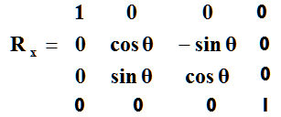
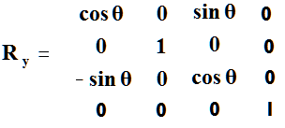
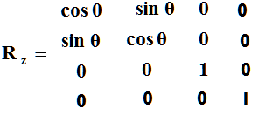
Rotation Matrices in 3D – Homogeneous Representation
Rotation around the X-Axis
Rotation around the Y-Axis
Rotation around the Z-Axis
26.09.2014

Slide 23
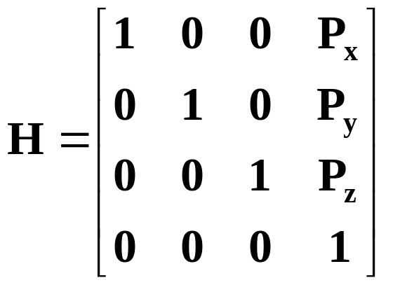
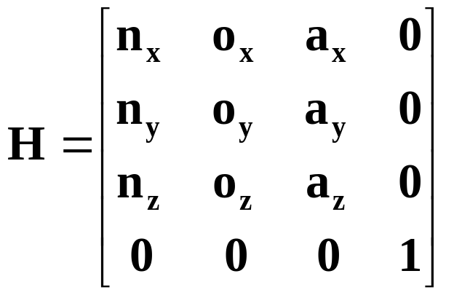
Homogenous Transformation in 3D
H is a 4x4 matrix that can describe a translation, rotation, or both in one matrix
O
Y
N
P
A
Rotation part:
Could be rotation around z-axis, x-axis, y-axis or a combination of the three.
X
Translation without rotation
Y
Z
N
X
Z
Rotation without translation
A
26.09.2014

Slide 24
An Important Point to Remember
The rotation and translation part can be combined into a single homogeneous matrix IF and ONLY IF both are relative to the same coordinate frame.
Generally defined with Respect to the so called World Reference Frame, usually placed at the base of the Robot
26.09.2014

Slide 25
Forward and Inverse kinematics of robot for position

Slide 26
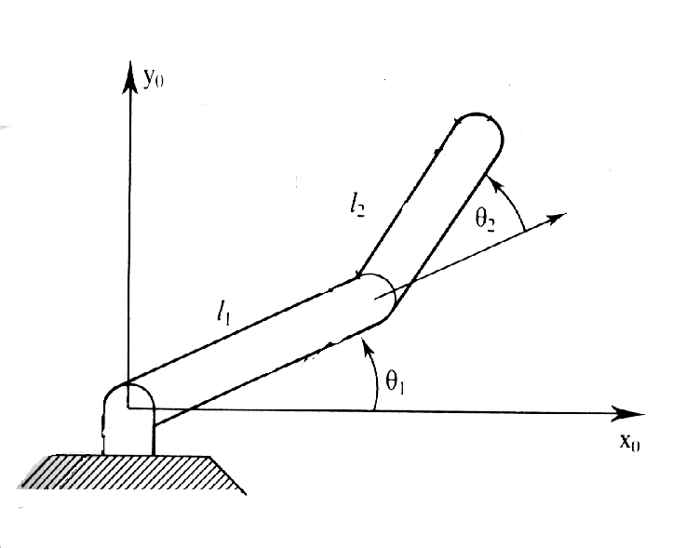
Forward Kinematics
The Situation:
  You have a robotic arm that starts out aligned with the x_{o}-axis.
  You tell the first link to move by ₁ and the second link to move by ₂.
The Quest:
  What is the position of the end of the robotic arm?
Solution:
  Geometric Approach
    This might be the easiest solution for the simple situation. However, notice that the angles are measured relative to the direction of the previous link. (The first link is the exception. The angle is measured relative to it’s initial position.) For robots with more links and whose arm extends into 3 dimensions the geometry gets much more tedious.
  Algebraic Approach
    Involves coordinate transformations.
26.09.2014

Slide 27
Types of robot co ordinates
One may position a point in space based on the following co ordinates
Cartesian (rectangular or Gantry)
Cylindrical
Spherical
Articulated
26.09.2014

Slide 28
Cartesian Co ordinate
There are 3 linear movements along the 3 major axes (X,Y,Z)
Positioning of the hand of the robot is accomplished by moving the 3 linear joints along the 3 axes
The transformation matrix representing the motion to a point P is a simple Translational transformation matrix since there are no rotations
26.09.2014

Slide 29
Cartesian Co ordinate
o
n
z
a
P
P_{z}
y
P_{x}
P_{y}
X
26.09.2014

Slide 30
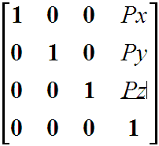
The transformation matrix representing the forward kinematic equation of the position of the hand of the robot in cartesian co ordinate system will be
        ^{R}T_{P} =
        Where ^{R}T_{P} = Transformation between the reference frame and the origin of the hand P
26.09.2014

Slide 31
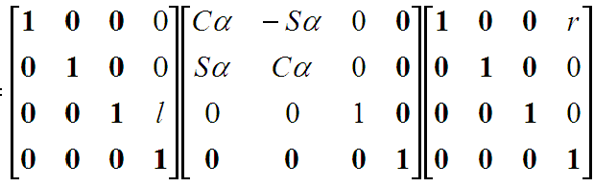
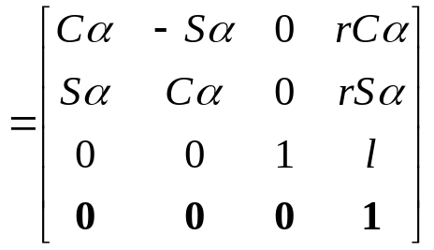
CYLINDRICAL CO ORDINATES
It includes 2 linear translation & 1 rotation .
The sequence is ,
      A translation of ‘r’ along x axis.
      A rotaion of ‘α’ along Z axis.
      A translation of ‘l’ along Z axis.
The total transformation caused by the three transformation that relates the origin of hand frame to the reference frame is obtained as,
^{R}T_{p =} T _{cyl} ( r,α,l) = Trans (0,0,l) Rot ( Z, α) Trans (r,0,0)
^{R}T_{p =}
Where P_{x} = r cos α ; P_{y} = r sin α ; P_{z} = l.
26.09.2014

Slide 32
CYLINDRICAL CO ORDINATES
n
o
z
a
P
l
y
α
r
X
26.09.2014

Slide 33
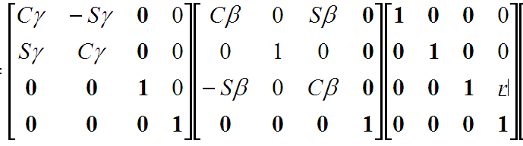
SPHERICAL CO-ORDINATES
This system consists of 1 linear & 2 rotations.
The sequence is ,
      A translation of ‘r’ along Z axis.
      A rotation of ‘β’ along Y axis.
      A rotation of ‘γ’ along Z axis.
The total transformation caused by the three transformation is
^{R}T_{p =} T _{sph} ( r, β, γ ) = Rot ( Z, γ) Rot (y, β) Trans (0,0,r)
^{R}T_{p =}
26.09.2014

Slide 34
SPHERICAL CO-ORDINATES
o
a
z
n
γ
β
P
y
X
26.09.2014

Slide 35
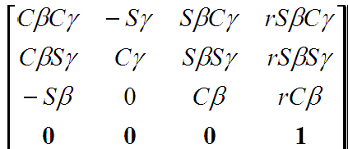
SPHERICAL CO-ORDINATES
RTp =
First three columns represents the orientation of the frame and last column
Represent the position of the origin.
26.09.2014

Slide 36
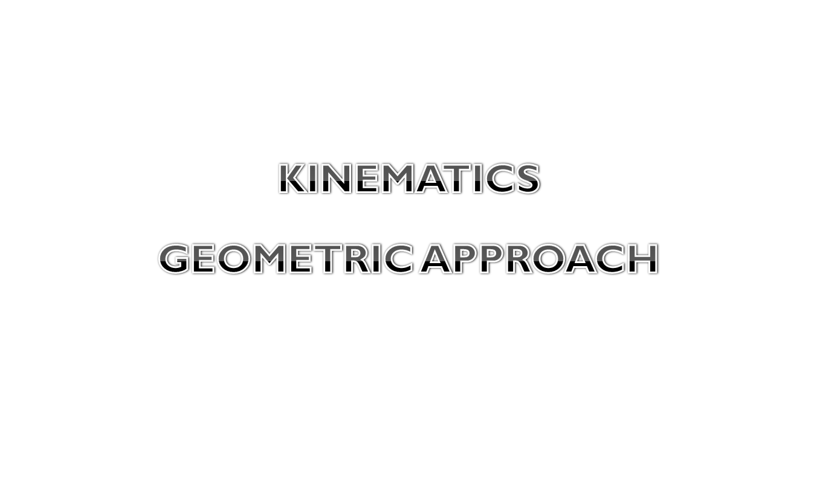
26.09.2014

Slide 37


One DOF Planar Robot
Direct Kinematics
x = L . cosθ
y = L . Sinθ
Inverse Kinematics
θ = tan⁻¹(y/x)
L – Link Length
θ = Angle of Rotation
y
(x, y)
L . sinθ
θ
x
L . cosθ
26.09.2014

Slide 38



Two DOF Planar Robot – Direct Kinematics
y
(x, y)
x = L₁ . cosθ₁ + L₂ . cos(θ₁+ θ₂)
y = L₁ . sinθ₁ + L₂ . sin(θ₁+ θ₂)
θ₂
L₂ . sin(θ₁+ θ₂)
L₂
L₁ . sinθ₁
L₁
θ₁
x
L₁ . cosθ₁
L₂ . cos(θ₁+ θ₂)
26.09.2014

Slide 39
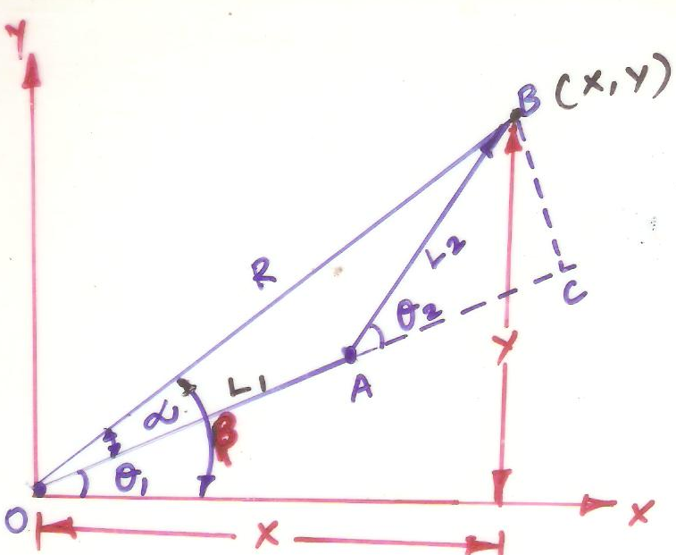
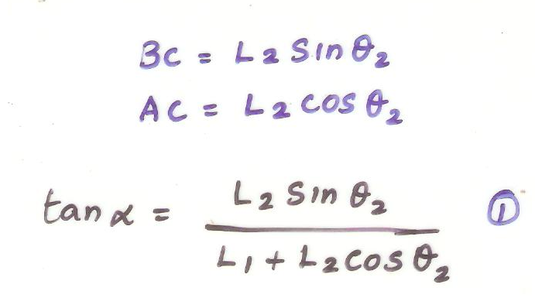

Two DOF Planar Robot - Inverse Kinematics
INVERSE KINEMATICS
Position of end of arm in world space in link vectors
26.09.2014

Slide 40
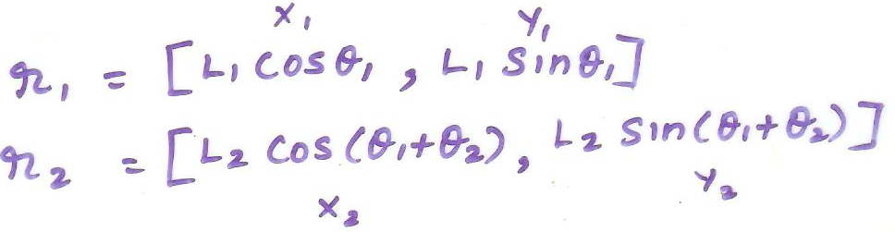
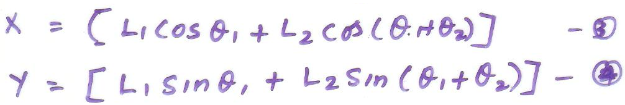
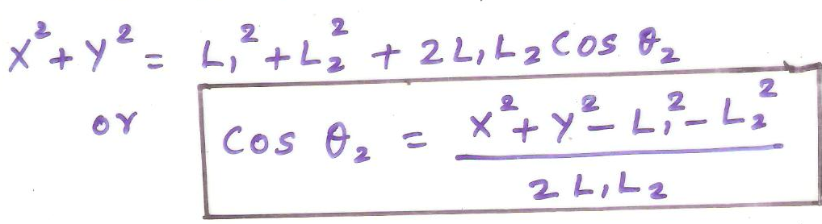
Two DOF Planar Robot - Inverse Kinematics
Squaring on both sides and adding
26.09.2014

Slide 41
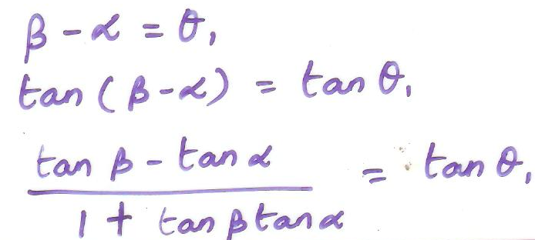
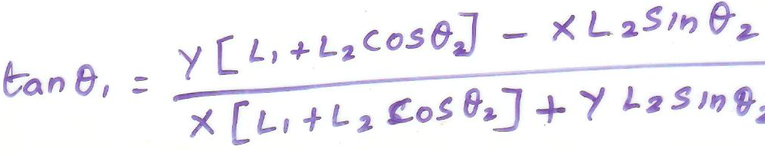
Two DOF Planar Robot - Inverse Kinematics
Also
26.09.2014

Slide 42




Two DOF Robot(spatial) – TR Configuration
Forward Kinematics
The direct kinematics equations of the TR robot configuration are
X = [L₁ cosθ] cosΦ
Y = L₁ sinθ
Z = [L₁ cosθ] sinΦ
Inverse Kinematics
Tan Φ = (Z/X)
Sinθ = (Y/ L)
y
X, Y, Z
θ
x
Φ
z
26.09.2014

Slide 43
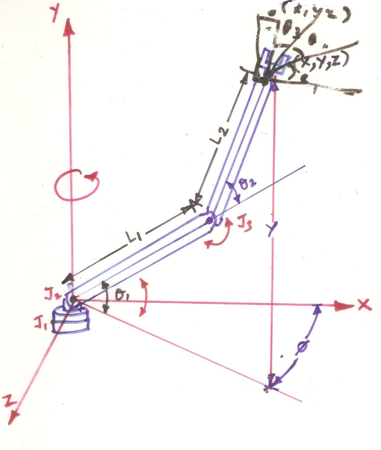
Three DOF TRR Configuration Robot
Direct Kinematics
26.09.2014

Slide 44
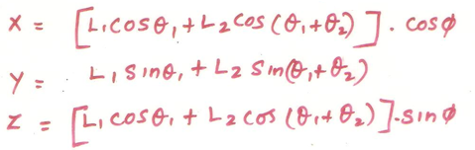
Three DOF TRR Configuration Robot
Direct Kinematics
The direct kinematic equations of the TRR robot configuration are
26.09.2014

Slide 45




Three DOF TRL Configuration Robot
Direct Kinematics
The direct kinematics equations of TRL configuration robot is
y
L
90 - Φ
L₁
L₁ sinΦ
Φ
X, Y, Z
X = (L₁cosΦ + LsinΦ) cosθ
Y = L₁sinΦ - LcosΦ)
Z = (L₁cos Φ + LsinΦ)sinθ
x
θ
z
26.09.2014

Slide 46
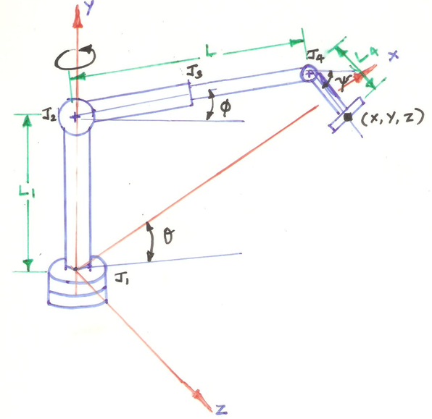
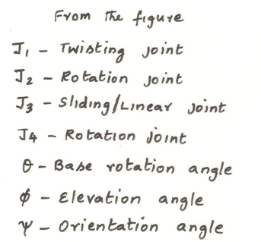
Four DOF TRLR Configuration Robot
Direct Kinematics
26.09.2014

Slide 47
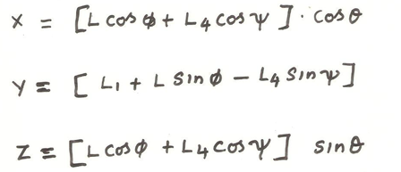
Four DOF TRLR Configuration Robot
Direct Kinematics
The direct kinematic equations of the TRLR robot configuration
26.09.2014

Slide 48
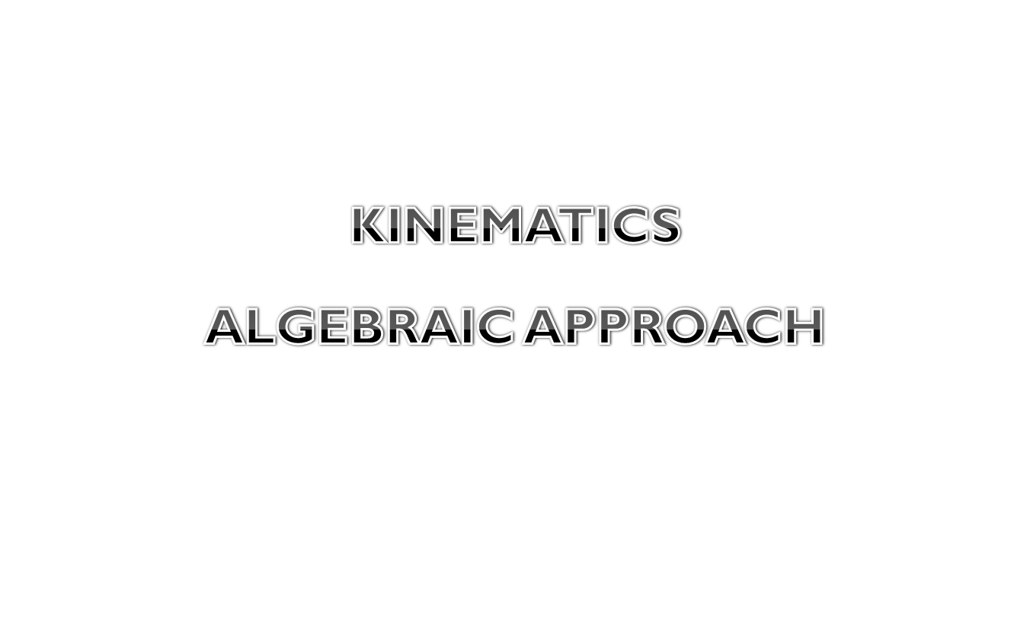
26.09.2014

Slide 49
The Denavit-Hartenberg Transformation
In 1955 Denavit and Hartenberg published a paper in ASME journal which was later used to represent and model robots and to derive their equations of motion.
The method can be used for any robot configuration, regardless of its sequence or complexity
Although the direct modeling is straight forward, it is important to understand D-H representation because many techniques (such as calculation of Jacobian, force analysis) have been developed for use with its results.
INDUSTRIAL ROBOTICS - TECHNOLOGY, PROGRAMMING AND APPLICATIONS
26.09.2014

Slide 50
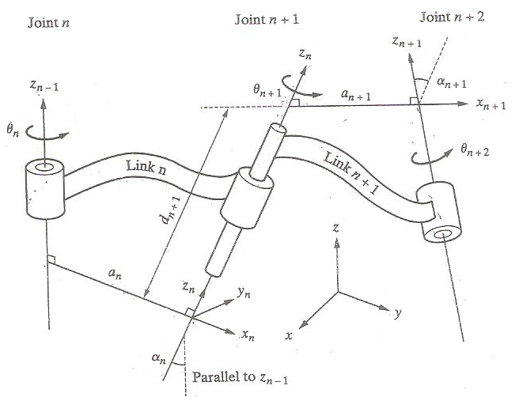
D-H Representation
INDUSTRIAL ROBOTICS - TECHNOLOGY, PROGRAMMING AND APPLICATIONS
26.09.2014

Slide 51
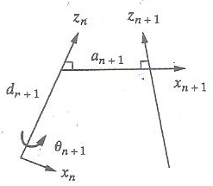
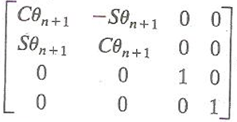
D-H Representation
Rotate about the z-axis an angle of θ_{n+1.} This will make x_{n} and x_{n+1} parallel to each other. This is true because a_{n} and a_{n+1} are both perpendicular to z_{n} and rotating z_{n} an angle of θ_{n+1} will make them parallel (and thus coplanar)
26.09.2014

Slide 52
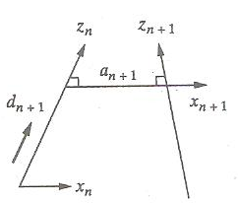
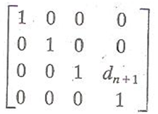
D-H Representation
Translate along the z_{n}-axis a distance of d_{n+1} to make x_{n} and x_{n+1} collinear. Since x_{n} and x_{n+1} were already parallel and normal to z_{n}, moving along z_{n} will lay them over each other.
26.09.2014

Slide 53
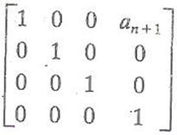
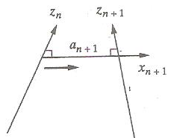
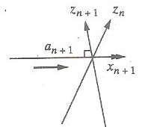
D-H Representation
Translate along the x_{n}-axis a distance of a_{n+1} to bring the origins of x_{n} and x_{n+1} together. At this point, the two origins of the two reference frames will be at the same location.
26.09.2014

Slide 54
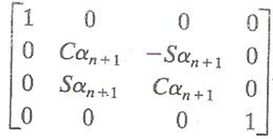
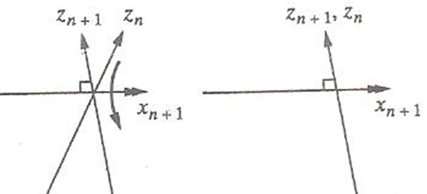
D-H Representation
Rotate z_{n}-axis about x_{n+1} – axis an angle of α_{n+1} to align z_{n}-axis with z_{n+1}-axis. At this point frames n and n+1 will be exactly the same and we will have transformed from one frame to the next.
26.09.2014

Slide 55
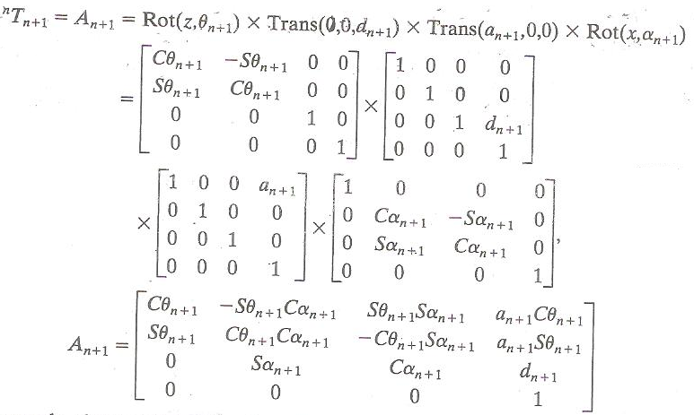
D-H Representation
26.09.2014

Slide 56
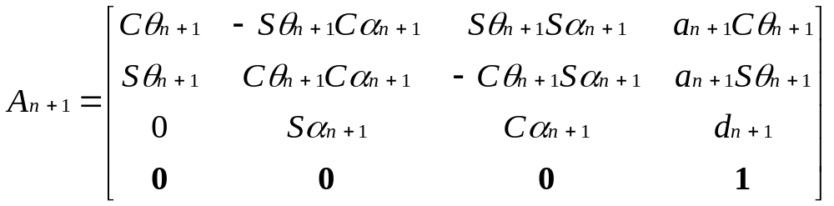
The general transformation matrix by D-H is given by
26.09.2014

Slide 57

D-H Representation
So in general once we know the individual transformations, the total transformation between the base of the robot and the hand will be
Where ‘n’ is the joint number.
For a six DOF robot, there will be six A matrices.
26.09.2014

Slide 58




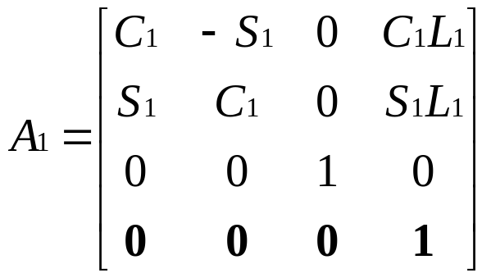
Direct Kinematics of(Planar) – 1DoF R Configuration Forward Kinematics
y
X, Y,
# | θ | d | a | α
1 | θ₁ | 0 | L₁ | 0
L₁
θ
x
General D-H transformation matrix
26.09.2014

Slide 59


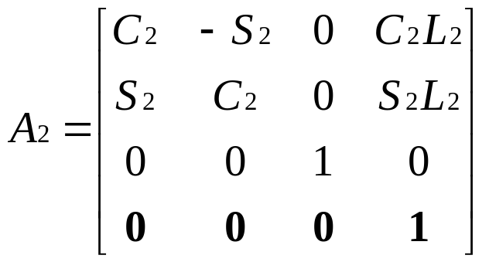

Two DOF Planar Robot – Direct Kinematics
# | θ | d | a | α
1 | θ₁ | 0 | L₁ | 0
2 | θ₂ | 0 | L₂ | 0
# | θ | d | a | α
1 | θ₁ | 0 | L₁ | 0
2 | θ₂ | 0 | L₂ | 0
y
(x, y)
θ₂
L₂
L₁
θ₁
x
26.09.2014

Slide 60
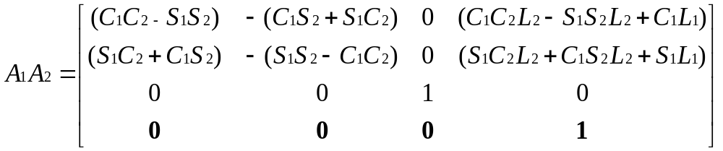
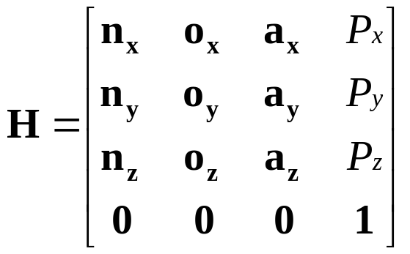
The above matrix is in the form
Px = L₂(C₁C₂- S₁S₂) + L₁C₁
Py = L₂(S₁C₂ +C₁S₂) +L₁S₁
Pz = 0
Transformation between base and hand is ^{R}T_{H} = A₁A₂
26.09.2014

Slide 61
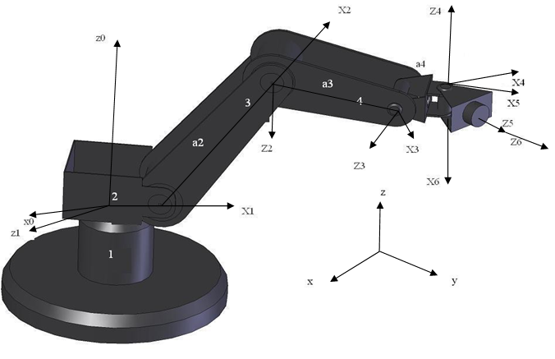
Frame Assignments
26.09.2014

Slide 62

TRR Configuration robot –forward kinematics using D-H matrix
General D-H transformation matrix
26.09.2014

Slide 63


D-H Representation of a 3DOF TRR configuration Robot
x₃
D-H Parameters
26.09.2014

Slide 64






Total transformation between the base of the robot and the hand is ^{R}T_{H}=
26.09.2014

Slide 65


The above matrix is in the form
P_{x}= [L₂(C₂C₃-S₂S₃) +C₂L₁]C₁
P_{Y} = [L₂(C₂C₃-S₂S₃) +S₂L₁]S₁
P_{Z} = L₂(S₂C₃+C₂S₃) +S₂L₁
26.09.2014

Slide 66
D-H Representation of a 6DOF Robot Frame Assignments
INDUSTRIAL ROBOTICS - TECHNOLOGY, PROGRAMMING AND APPLICATIONS
20-12-2010

Slide 67

Frame Assignments
26.09.2014

Slide 68
D-H Parameters
26.09.2014

Slide 69


Transformation Matrices
26.09.2014

Slide 70


D-H Representation
The final transformation matrix is
given by
Note for the sake of simplicity the following trignometric function is used
26.09.2014

Slide 71
Matrix Inversion
The following steps are taken for calculating the inverse of a matrix
  Calculate the determinant of the matrix
  Transpose the matrix
  Replace each element of the transposed matrix by its own minor (adjoint matrix)
  Divide the adjoint matrix by the determinant
  A⁻¹ = adj [A] / det [A]
26.09.2014

Slide 72


Matrix Inversion - Example
Consider
1. Applying the process to the rotation matrix for finding the value of ∆
∆ = 1(cos² θ + sin² θ)+0 = 1
2. Transpose the rotation matrix
T
26.09.2014

Slide 73

Matrix Inversion - Example
26.09.2014

Slide 74

Matrix Inversion – Alternative Method
26.09.2014

Slide 75

Matrix Inversion – Alternative Method
26.09.2014

Slide 76

Matrix Inversion – Alternative Method
26.09.2014

Slide 77






Inverse Kinematics of a 2DOF RR Robot
# | θ | d | a | α
1 | θ₁ | 0 | L₁ | 0
2 | θ₂ | 0 | L₂ | 0
θ₂
To find the set of angles, the position and orientation of the end effector is given in a matrix of the form
θ₁
26.09.2014

Slide 78

To solve for the angles we will successfully premultiply the two matrices starting with A₁⁻¹
A₁⁻¹
=
(A₁⁻¹)
⁽A₁A₂)
=
A₂
26.09.2014

Slide 79



To find A₁⁻¹
P..n = P_{x}.n_{x} + P_{y}.n_{y}+P_{z}.n_{z}
P.o = P_{x}.o_{x} + P_{y}.o_{y}+P_{z}.o_{z}
P.a = P_{x}.a_{x}+P_{y}.a_{y}+P_{z}.a_{z}
26.09.2014

Slide 80



26.09.2014

Slide 81
a_{x}C₁+a_{y}S₁=0 (1)
-a_{x}S₁+a_{y}C₁=0 (2)
n_{x}C₁+n_{y}S₁=C₂ (3)
o_{x}C₁+o_{y}S₁= -S₂ (4)
P_{x}C₁+P_{y}S₁-L₁=C₂L₂ (5)
-P_{x}S₁+P_{y}C₁=S₂L₂ (6)
-n_{x}S₁+n_{y}C₁=S₂ (7)
-o_{x}S₁+o_{y}C₁=C₂ (8)
P_{z}=0 (9)
a_{z}=1 (10)
26.09.2014

Slide 82
To Find The value of theta 2
Concider eqn no. (5)& eqn. no (6)
P_{x}C₁+P_{y}S₁-L₁=C₂L₂ (5)
(P_{x}C₁+P_{y}S₁) = (C₂L₂-L₁) (A)
( -P_{x}S₁+P_{y}C₁)=S₂L₂ (B)
Squaring both sides and adding eqn (A)& (B)
(P_{x}C₁+P_{y}S₁)² = (C₂L₂-L₁)²
( -P_{x}S₁+P_{x}C₁) ² = (S₂L₂) ²
P_{x}² ₊P_{y}² = L₁² + L₂² +2L₁L₂C₂
From the above equation
C₂ = P_{x}² ₊P_{y}² - L₁² - L₂² / 2L₁L₂
26.09.2014

Slide 83
To find the value of theta 1
Concider eqn no. (5)
P_{x}C₁+P_{y}S₁-L₁=C₂L₂ (5)
Divide eqn.(5) by C₁
P_{x}+P_{y}S₁/C₁ -L₁/C₁ = C₂ L₂ /C₁
P_{x} = C₂ L₂ /C₁ -P_{y}S₁/C₁ + L₁/C₁ (A)
Substituting (A) in eqn.(6)
-P_{x}S₁+P_{y}C₁=S₂L₂ (6)
-(C₂ L₂ /C₁ -P_{y}S₁/C₁ + L₁/C₁) S₁+P_{y}C₁=S₂L₂ (B)
Multiply eqn. (B) by C₁
-(C₂ L₂ –P_{y}S₁ + L₁) S₁+P_{y}C₁²=S₂L₂C₁
-(C₂ L₂S₁ –P_{y}S₁² + L₁S₁) +P_{y}C₁²=S₂L₂C₁
C₁ =( -C₂ L₂S₁ +P_{y}- L₁S₁) / S₂L₂ (X)
26.09.2014

Slide 84
From eqn.(6)
( -P_{x}S₁+P_{y}C₁)=S₂L₂
C₁= (S₂L₂+P_{x}S₁) / P_{y} (y)
Comparing (x) & (y)
(S₂L₂+P_{x}S₁) / P_{y} =( -C₂ L₂S₁ +P_{y}- L₁S₁) / S₂L₂
By solving the set of equations Theta 1 can be calculated as
P_{y}[L₁+L₂C₂]-P_{x}L₂S₂ / P_{x}[L₁+L₂C₂]+P_{y}L₂S₂ = S₁/C₁
26.09.2014

Slide 85

A Case Study
COMBAT VEHICLE
MANIPULATOR
26.09.2014

Slide 86

26.09.2014

Slide 87

26.09.2014

Slide 88

26.09.2014

Slide 89

26.09.2014

Slide 90

26.09.2014

Slide 91

D-H Representation
26.09.2014

Slide 92
Joint | Ө | d | a | α
1 | Ө₁ | 0 | L₁ | -90(cw)
2 | Ө₂ | 0 | L₂ | +90(ccw)
3 | Ө₃ | 0 | L₃ | 0
4 | Ө₄ | 0 | L₄ | 0
Where
Ө = rotation about Z axis
d = distance on the Z axis between two successive normals
a = length of each common normal (joint offset)
α = the angle between successive Z axis ( joint twist)
26.09.2014

Slide 93

A_{n+1} = C Ø_{n+1} - S Ø_{n+1} C α_{n+1} S Ø_{n+1} S α_{n+1} a_{n+1} C Ø_{n+1}
S Ø_{n+1} CØ_{n+1} C α_{n+1} -C Ø_{n+1} S α_{n+1} a_{n+1} S Ø_{n+1}
0 S α_{n+1} C α_{n+1} d_{n+1}
0 0 0 1
Substituting n=0 in above equation we get four rotational transformation motions from the table values and matrices are listed below
26.09.2014

Slide 94

The total transformation between the base of the robot manipulator and hand is:
^{R}T_{H} = A₁ A₂ A₃ A₄
Multiplying all the above
26.09.2014

Slide 95

26.09.2014

Slide 96

The general form of above matrix is given as below and comparing its element
^{R}T_{H} =
26.09.2014

Slide 97
Where,
n_{x}= C₁C₂C₃₄ - S₁S₃₄
n_{y}= S₁C₂C₃₄ + C₁S₃₄
n_{z}= -S₂C₃₄
o_{x}= -C₁C₂S₃₄ - S₁C₃₄
o_{y}= - S₁C₂ S₃₄ - C₁C₃₄
o_{z}= S₂ S₃₄
a_{x} = C₁S₂
a_{y} = S₁S₂
a_{z} = C₂
p_{x}= C₁C₂L₄C₃₄ - S₁L₄ S₃₄ + C₁C₂L₃C₃-S₁S₃L₃ +C₁L₂C₂+L₁C₁
p_{y}= S₁C₂ L₄ C₃₄ + C₁L₄S₃₄ +S₁C₂C₃L₃+S₁C₂C₃L₃+C₁L₃S₃+S₁L₂C₂+L₁S₁
p_{z}= -S₂ L₄ C₃₄-S₂L₃C₃-L₂S₂
26.09.2014

Slide 98
INTRODUCTION
Robot Manipulators Types
1.Serial (Open Chain) 2.Parallel ( Closed Chain)
Parallel mechanisms have long been recognized to offer superior rigidity, load to weight ratio than serial manipulators.
A parallel manipulator typically consists of mobile platform that is connected to a fixed base by several limbs or legs.
Types of Parallel Manipulators
1.Glide type, 2.Pod type
Applications
Walking machines, Mining machines ,Pointing devices, Adjustable articulated trusses, Airplane simulators, Automatic assembly Contour milling, Angular machining operations 26.09.2014

Slide 99

General 3-DOF PARALLEL MANIPULATOR
A 3- DOF PM consists of an upper platform, three rigid links and base platform.
A base Cartesian coordinate system X,Y and Z (global coordinate system) is fixed at the centre of the base platform with Z axis pointing vertically upward and the X axis pointing towards the pin joint 1.
Similarly a local coordinate system x,y and z is assigned to the centre of the upper platform with the z axis normal to the platform and x axis pointing towards the spherical joint 1.
Figure 1. Schematic diagram of 3 DOF Parallel Manipulator
26.09.2014

Slide 100


Figures 2 and 3. show the 3-PRS Tripod and Tri-Glide PMs
The revolute joint is attached to the nut, which is mounted on the guide way. The guide way consists of a lead screw and two guide rods.
The mobility or motion of the MP is accomplished by the screw and nut pairs on the guide ways.
Figure 3 Tri-Glide PM
Figure 2 Tripod PM
26.09.2014

Slide 101

MOBILITY EQUATION
The degrees of freedom (DOF) of this mechanism is calculated by using the Gruebler - Kutzbach Mobility Equation.
where, λ = Degrees of freedom , N = Total number of bodies, J = Total number of joints and F_{i} = Degrees of freedom of the i^{th} joint.
N = 8 (3 links, + 3 nuts + 1 MP and 1 Base )
J = number of joints = 9 (3 Spherical, 3 Revolute and 3 Prismatic Joints)
F_{i} = number of degrees of freedom of the ith joint = 3 for each spherical joint and F_{i} =1 for each revolute joints and for screw joint.
Application of Equation yields the degrees of freedom F= 3.
Rotation about x axis 2) Rotation about y axis 3) Translation along z axis
26.09.2014

Slide 102


KINEMATICS OF SINGLE LINK MOVEMENT
Two coordinate systems (global and local) are used to describe the position of the mobile platform of the manipulator, as shown in Figure 4.
The kinematics also considers the motion conversion in the spherical joints (S₁, S₂ and S₃) and the pin joints (P₁, P₂ and P₃).
a) MP b) BP
Figure 4. Geometrical representation of the MP and BP of the two PMs
26.09.2014

Slide 103


The spherical joints 1 and 3 are considered as fixed when the link connected with spherical joint 2 is actuated.
Single link movement of Tripod
X – Horizontal Distance in mm
Z – Vertical height in mm
D – Displacement of nut in mm
L₁=1.5r
r – Mobile platform radius in mm
θ – Initial angle in deg
α – Angle of tilt in deg
L – Link Length in mm
Figure 5 Single link movement of Tripod
26.09.2014

Slide 104

Equations are formulated based on the arrangement of the single link movement of the Tripod PM.
The input parameters of the single link movement are link length (L), nut
displacement (D), mobile platform radius (r), initial angle between link and
base platform (θ). The output parameter is mobile platform tilt (α).
26.09.2014

Slide 105


Towards the Centre (Tri-Glide (A))
Away from the Centre
(Tri-Glide (B))
26.09.2014

Slide 106



26.09.2014

Slide 107


EXPERIMENTAL PROTOTYPES
TRIPOD PM
TRI-GLIDE PM
26.09.2014

Slide 108

METHODS USED IN POSITION ANALYSIS
A laser torch is mounted on the center ‘C’ of the MP, and the laser light is projected on the vertical screen at a point ‘A’, which is at a predetermined distance ‘AC’ from the point of the laser source.
When the MP is tilted by the actuation of the link, the laser beam gets deflected to some other point ‘B’ on the vertical screen. The angle of tilt of the MP is measured from the orientation of the source.
From Figure 6, the MP tilt angle (α) is measured from the following Equation
α= tan⁻¹(AB / AC)
Figure 6 Calculation of angle of tilt of the MP
26.09.2014

Slide 109


Experimental Method
TRIPOD PM
TRI-GLIDE PM
26.09.2014

Slide 110



Figure 7 Positioning of laser torch
Figure 7(a) Laser source on screen at initial position
Figure 8 Initial position of PM with laser torch
Figure 9 Final position of PM with laser torch

Slide 111


METHODS USED IN POSITION ANALYSIS
Figure 10 Laser source on screen at final position
Figure 11 Laser source positions on screen
26.09.2014

Slide 112
The Experimental models of the Tripod and Tri-Glide (B) PMs are fabricated with a Link length of 300 mm, MP radius of 90 mm and the initial angle of θ=70°.
Table 1 Results of the angle of tilt of the MP for the nut displacement of 90 mm by experimental and ADAMS methods
Actuation Link Number | Angle of tilt of MP (degrees)
 | Experiment |  | ADAMS
 | About the X axis α | About the Y axis β | About the X axis α | About the Y axis β
1 | 34.69 | 0 | 35.25 | 0
2 | 16.29 | 30.31 | 16.58 | 30.51
3 | 16.02 | 30.31 | 16.58 | 30.51
The experimental method shows a deviation of 3.5% (for the x axis MP tilt) when compared with the analytical method.
The ADAMS results are compared with the experimental results. It is found that it has a maximum deviation of 3.5%.
26.09.2014

Slide 113
Table 2 Results of the angle of tilt of the MP for the nut displacement of 90 mm by experimental and ADAMS methods
Actuation Link No. | Angular Tilt of MP (degrees)
 | Experiment |  | ADAMS
 | About X axis α | About Y axis β | About X axis α | About Y axisβ
1 | 30.72 | 0 | 30.98 | 0
2 | 14.41 | 27.38 | 14.92 | 27.48
3 | 14.41 | 27.20 | 14.92 | 27.48
The experimental method shows a deviation of 0.9% (for the x axis MP tilt), when compared with the analytical method.
The ADAMS results are compared with experimental results. It is found that it has a maximum deviation of 3.54%.
26.09.2014

Slide 114

The ADAMS simulation results of the Tripod and Tri-Glide PMs for the Link actuation 2 are shown in Figures. Similarly, the other simulation results are obtained.

Slide 115


Slide 116
THANK YOU
26.09.2014

